Slide 1
Intro to Processing
+ Agile Techniques
Workshop 2
Ruzanna Chitchyan, Jon Bird, Pete Bennett
TAs: Mitch Lui, Craig Barnfield, Kira Clements, Ollie Myers
Notes:
Simon

Slide 2
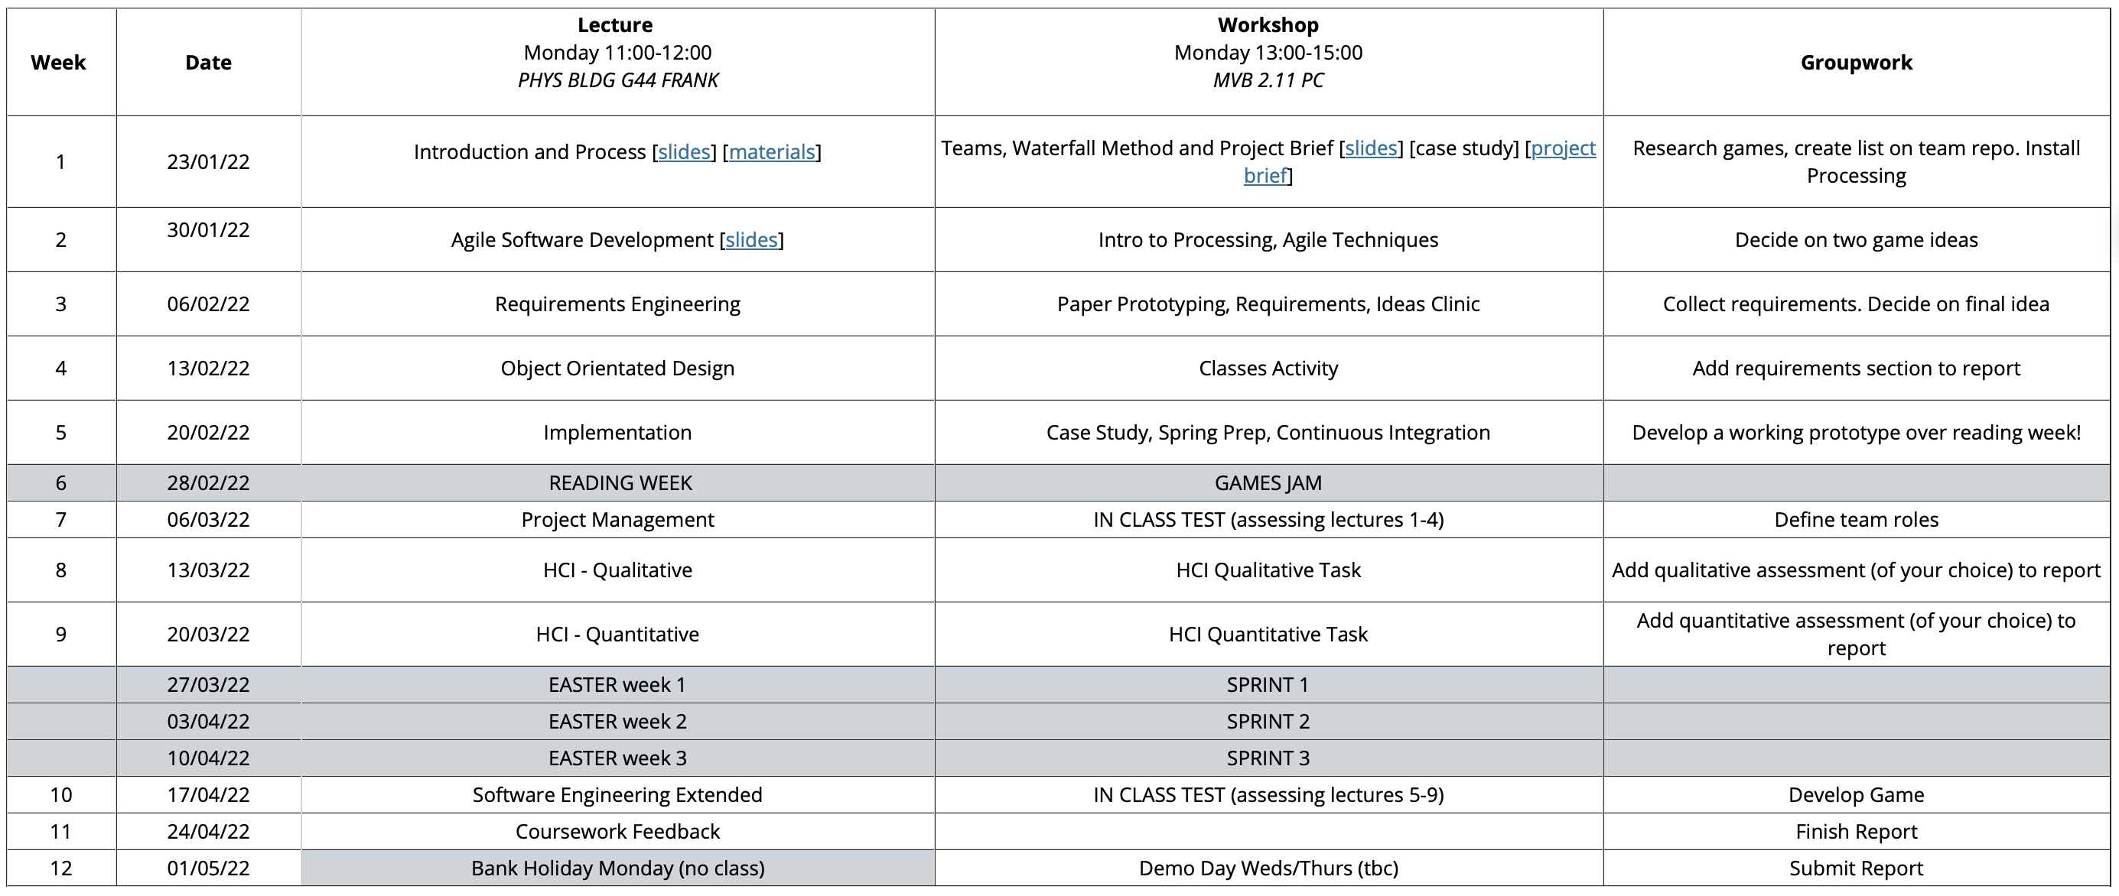

Slide 3
Coursework
Any questions about the coursework brief?
Have you made contact with everyone in your team? Let us know now if not!
Have you made a commit on your repo using Mitch’s git introduction from Software Tools?

Slide 4
Today’s Workshop
attendance code: ????
Introduction to Processing (15mins)
Develop an app (~ 80 mins)
  Practice Pair Programming
  Practice Kanban board use
Try some (very light) evaluation (15mins)

Slide 5
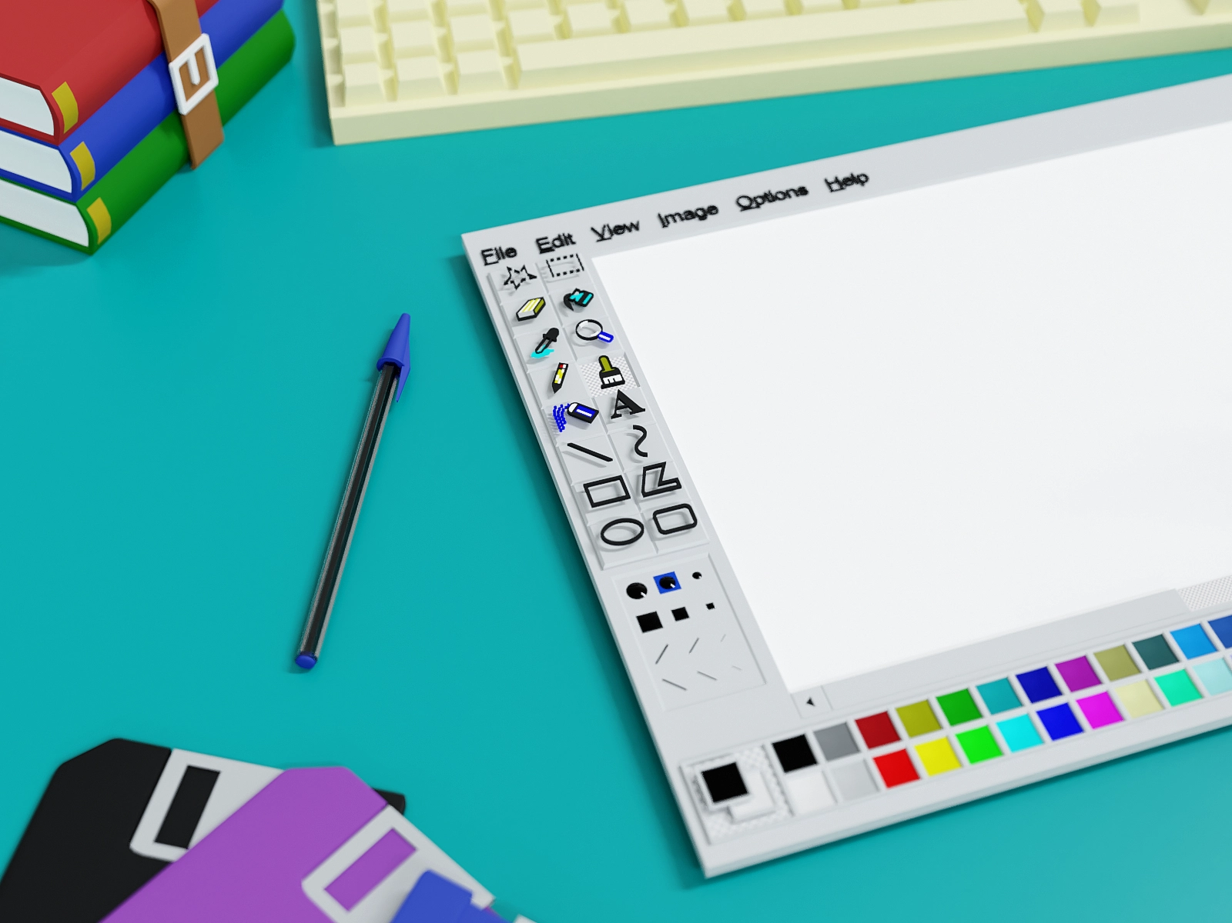
Simple Paint
Today you are going to develop in pairs a simple drawing tool in Processing.开发一个简单的绘图工具
Inspired by the classic Microsoft Paint, but… this is only a starting point, you will be adding any features you like.
You will be swapping your paint app with another pair at the end to draw a portrait
…keep this use in mind before going off and making an abstract generative geometric paint program!
image

Slide 6
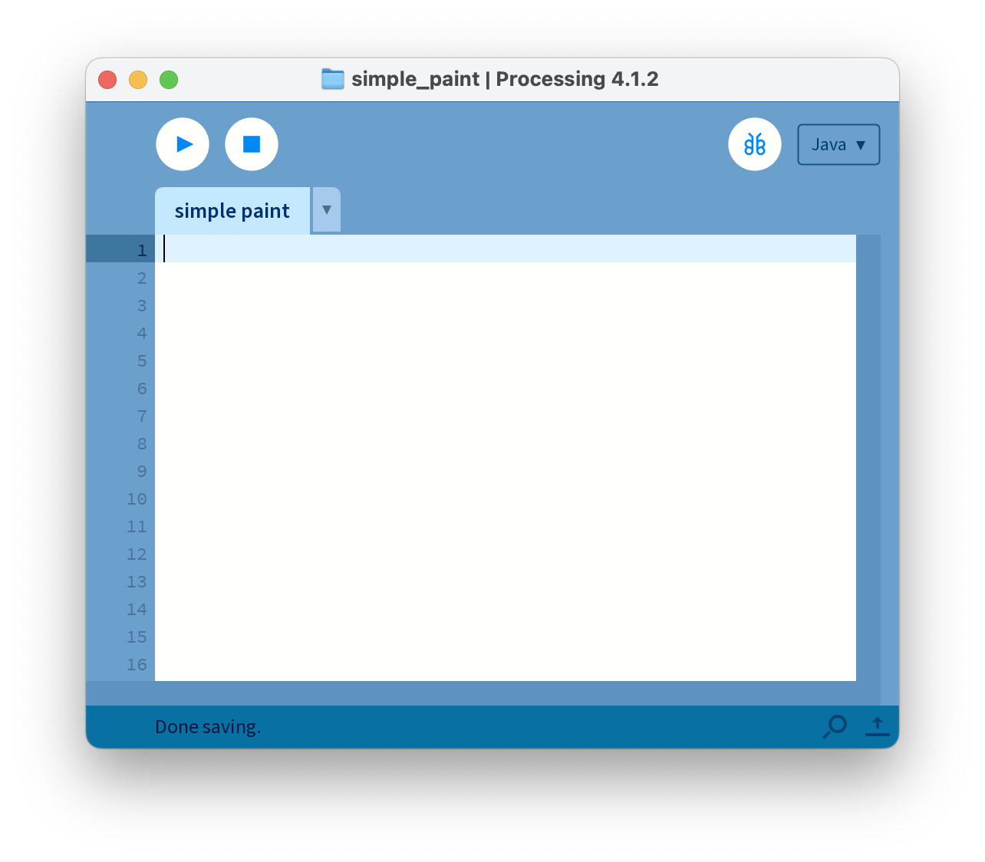
Live Demo
Follow along with this quick demo.
This will start you all off with a very bare bones Minimum Viable Product (MVP)
If you miss anything, the steps I’ll show you now are in the following slides.

Slide 7
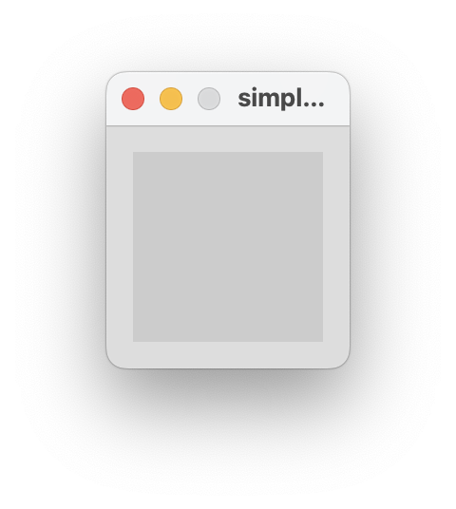
Run + Stop
Use the start and stop buttons to start and stop your sketch from running.
If you run and empty sketch, it will still work!

Slide 8
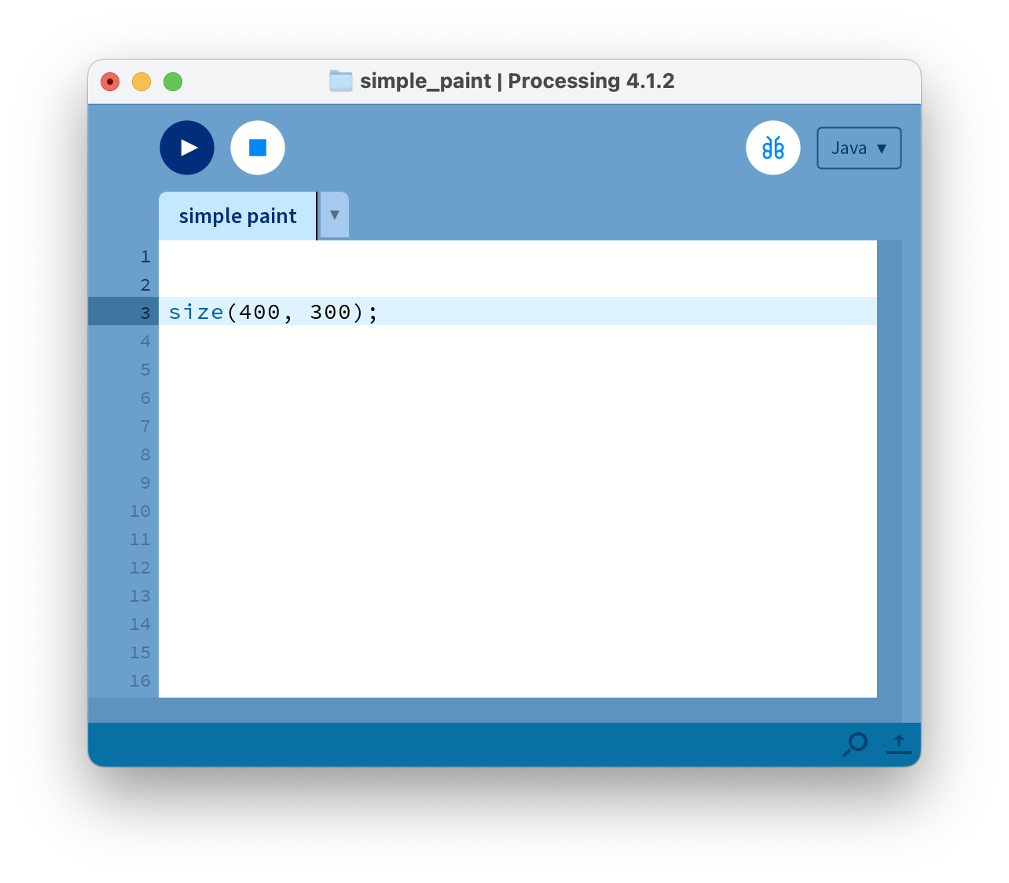
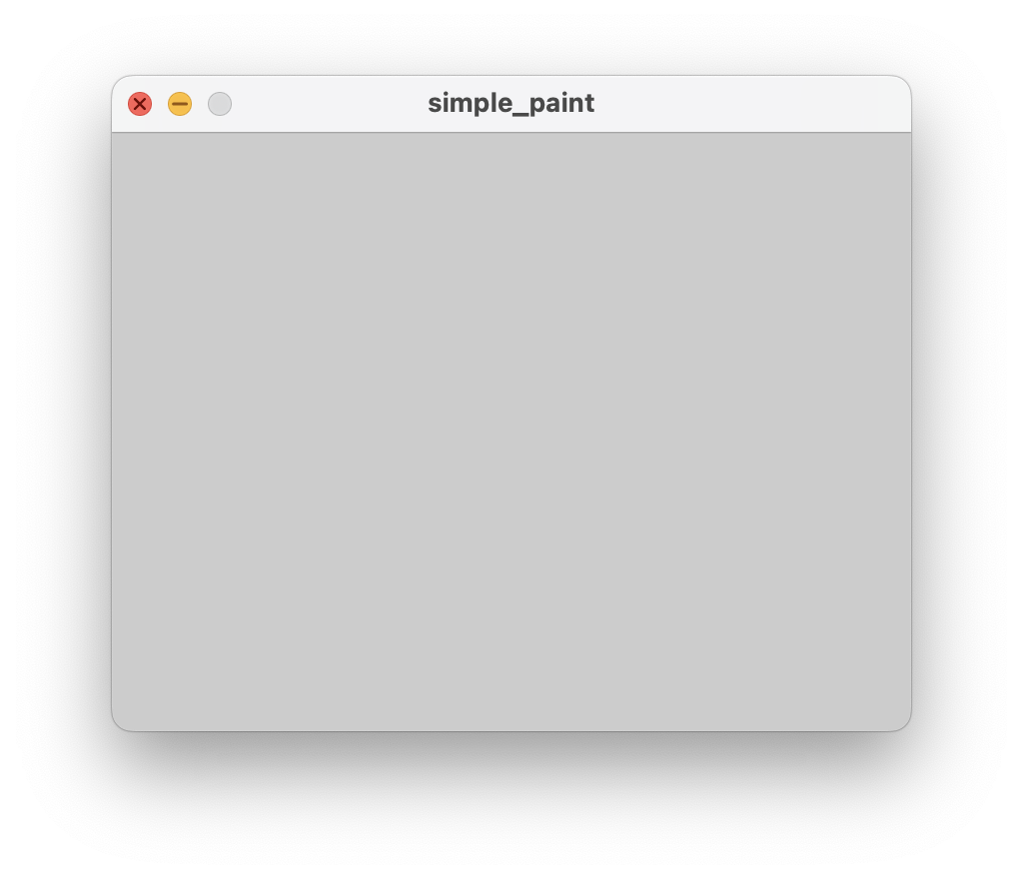
Canvas Size
First task is to make the canvas a bit larger with the size function:
  size(width, height);
  size(400, 300);
the size is set in pixels
Don’t forget the semi-colon

Slide 9
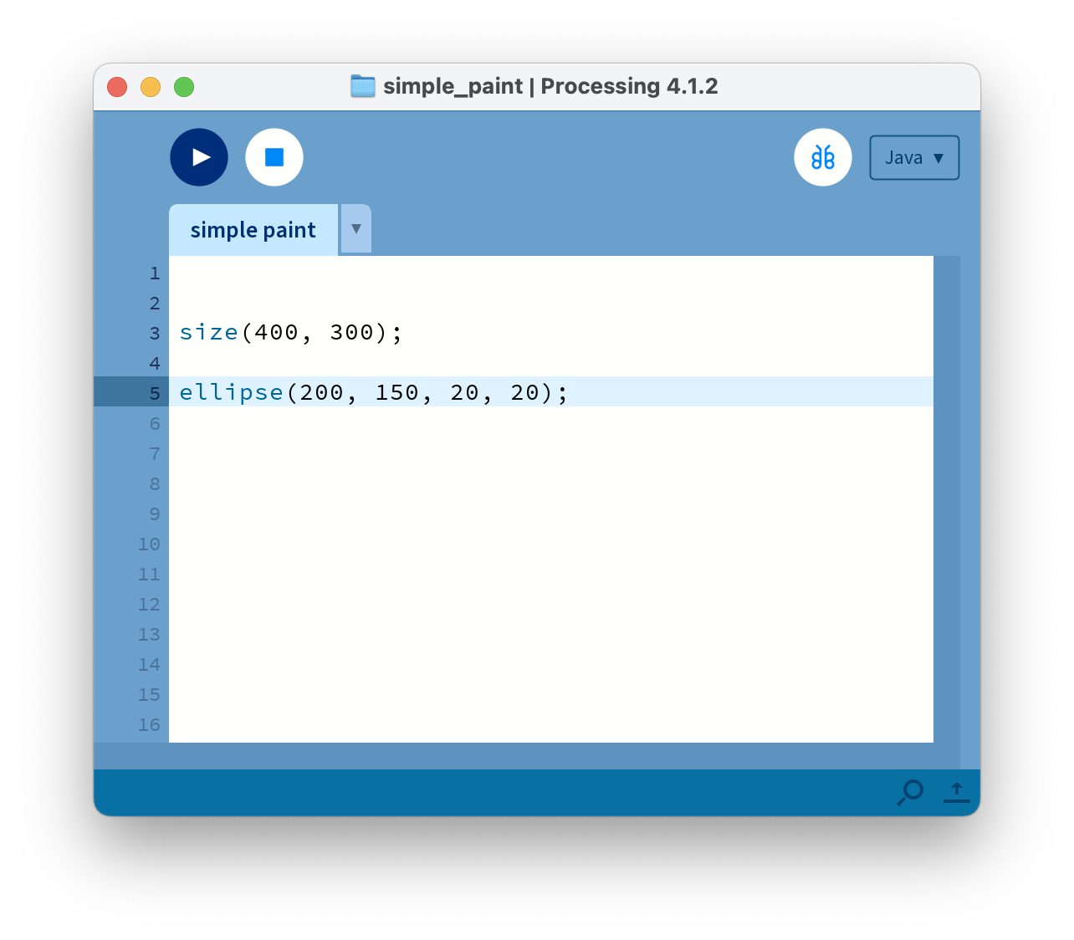
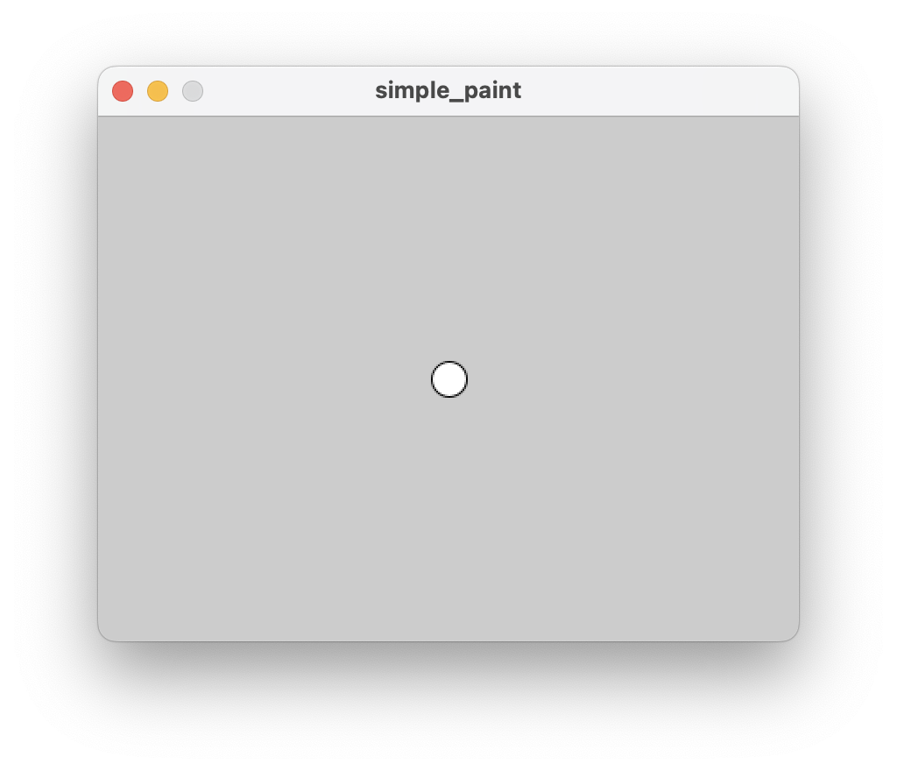
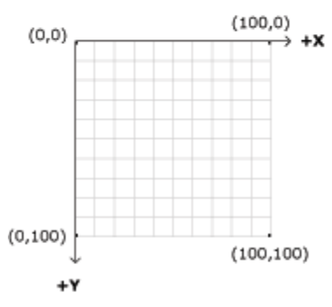
Draw a Circle
Now draw a circle using the ellipse function that takes four arguments:
  ellipse(x, y, width, height);
  ellipse(200, 150, 20, 20);
To draw a rectangle use:
  rect(x, y, width, height);
Coordinate system: top left is 0, 0

Slide 10
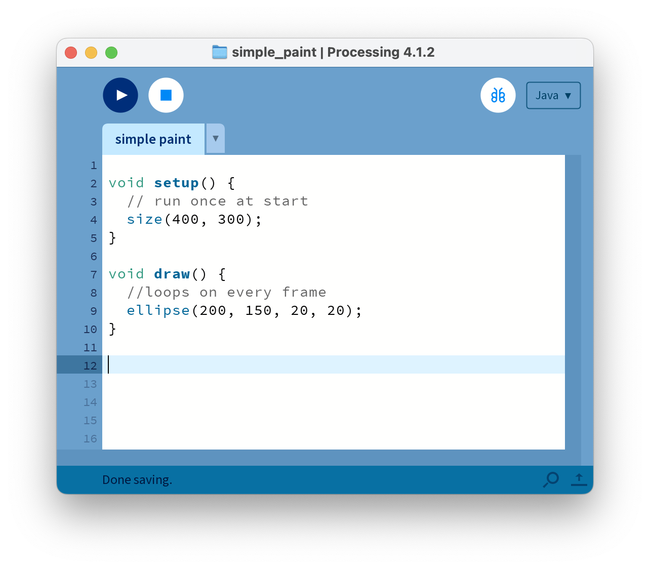
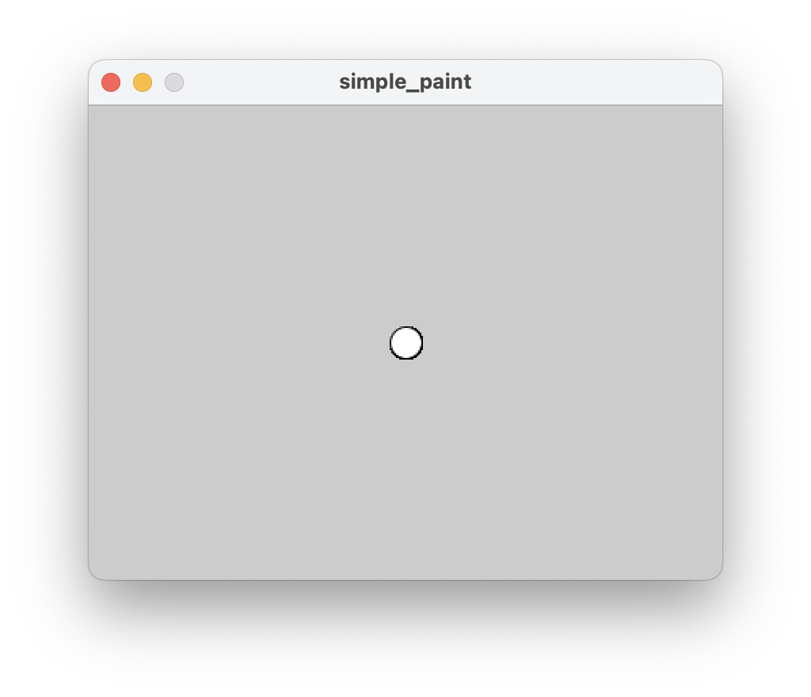
setup & draw
The last sketch ran through only once then stops. This can work for some non-interactive applications, but we want to be able to animate! So we need to use setup and draw functions:
void setup() {
// runs once at the start
}
void draw() {
// runs every frame in a loop
}

Slide 11
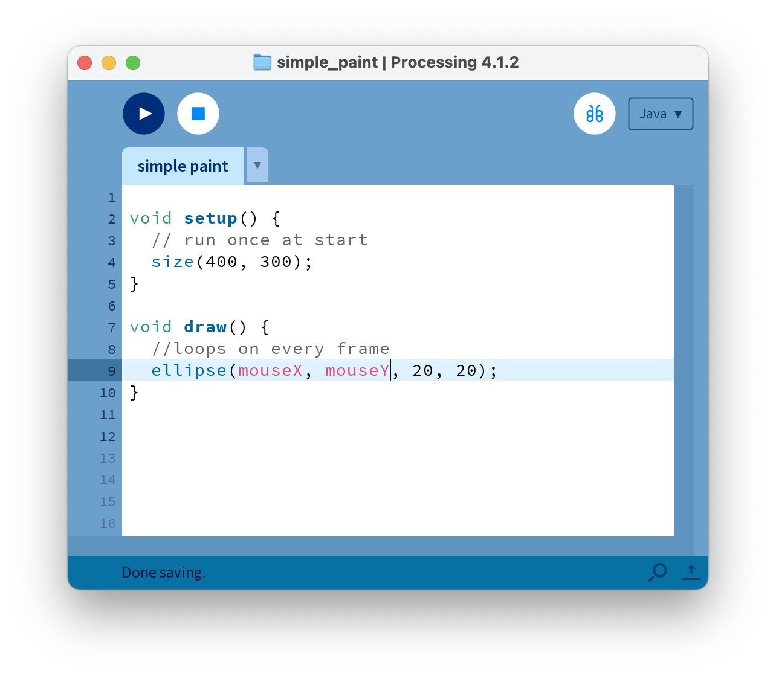
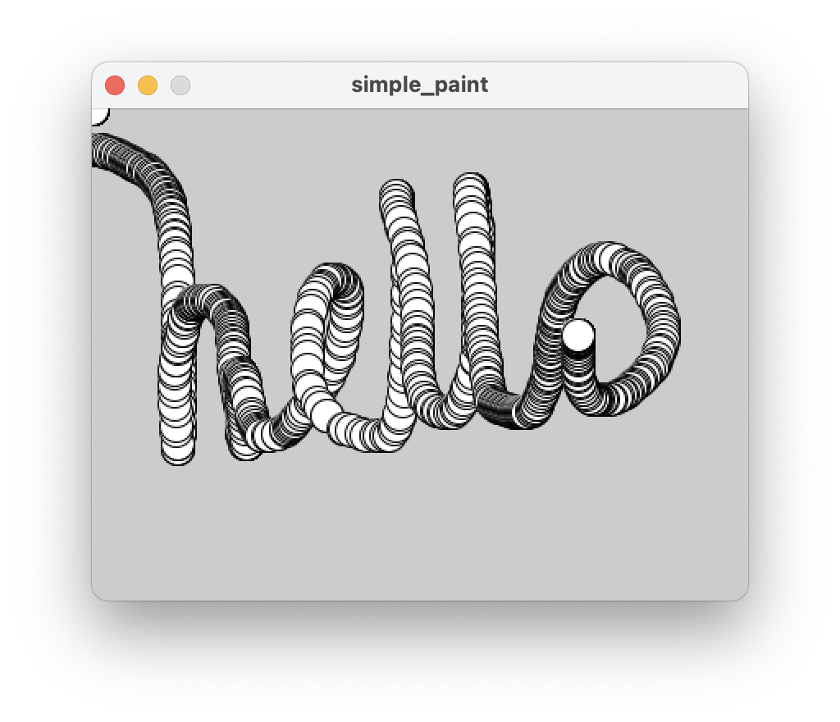
mouseX & mouseY
Processing has some handy global variables predefined that you can access
  mouseX returns the current mouse x pos
  mouseY returns the current mouse y pos
The IDE highlights the variable pink to show that it’s a predefined variable.
Other useful ones include width, height of the sketch window. And previous mouse positions pmouseX and pmouseY.

Slide 12
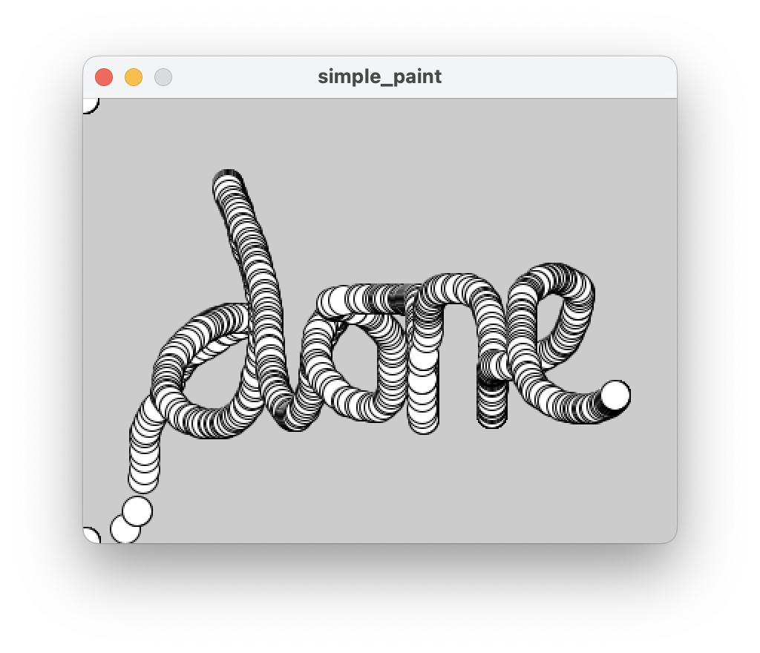
MVP achieved!
You all now have the starting point of a very basic paint program.
  Try painting the person next to you.
Your job for the remainder of the workshop is to work in pairs using pair programming and a kanban board to improve on this.
You will be testing your creation out on another person (with no instructions!) to make a short life drawing portrait at the end of the workshop. But… here are some starting points:

Slide 13
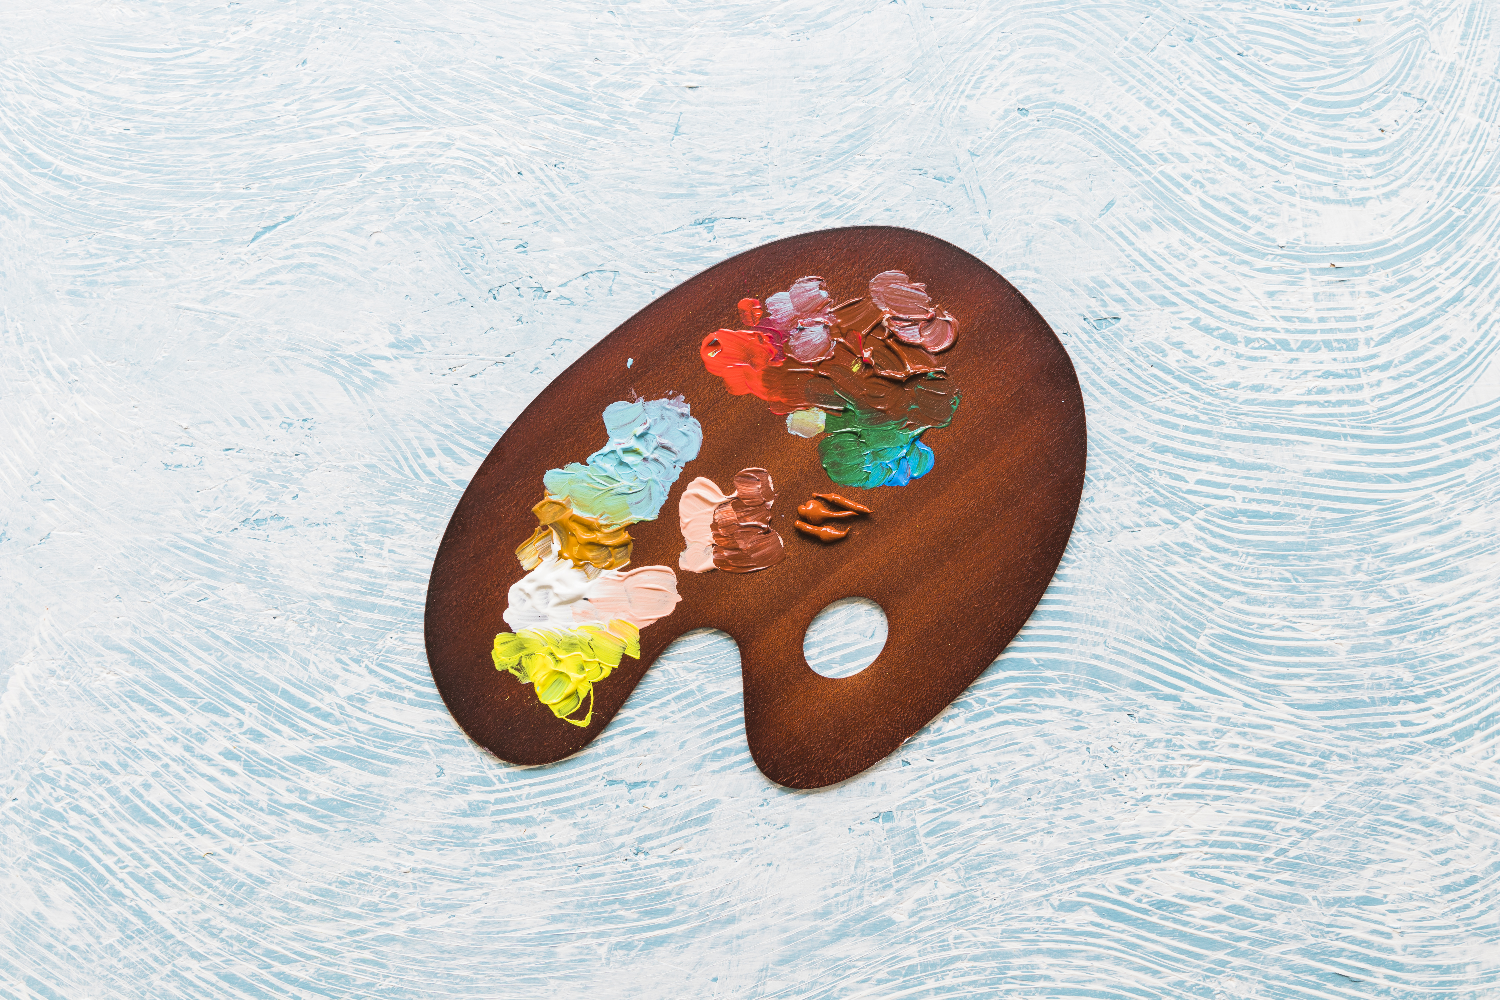
Changing Colour
Colours values are between 0-255
fill(red, green blue)
  Changes the fill colour for the next drawing command.
stroke(red, green, blue)
  Change the colour for the outline of the next shape
image

Slide 14
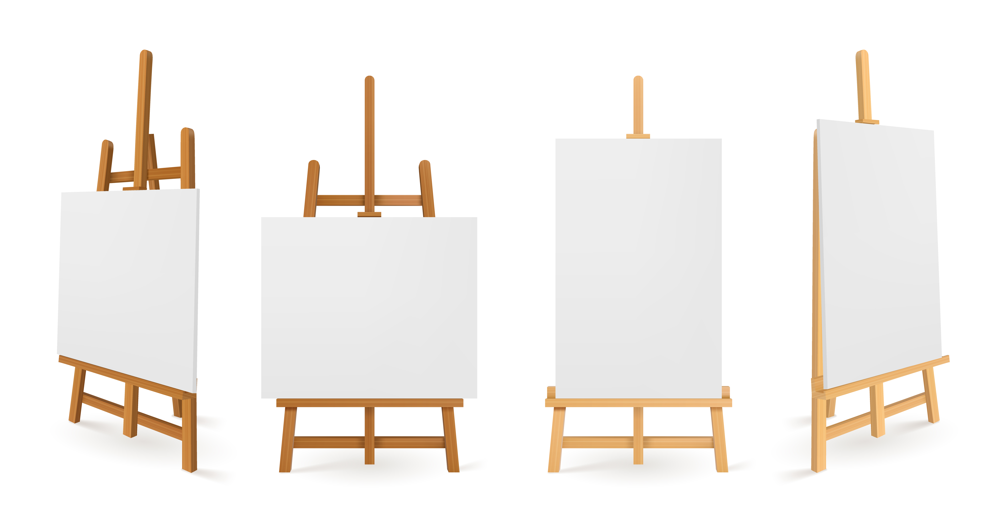

Canvas / Background
Change the background colour of the sketch by calling background(r,g,b)
Try loading an image as a background using image() … note, do this in setup, rather than the draw loop!
Explore using paper, canvas textures, a sketchbook or use a photograph (say of sky + clouds for a cloud drawing app)
image

Slide 15
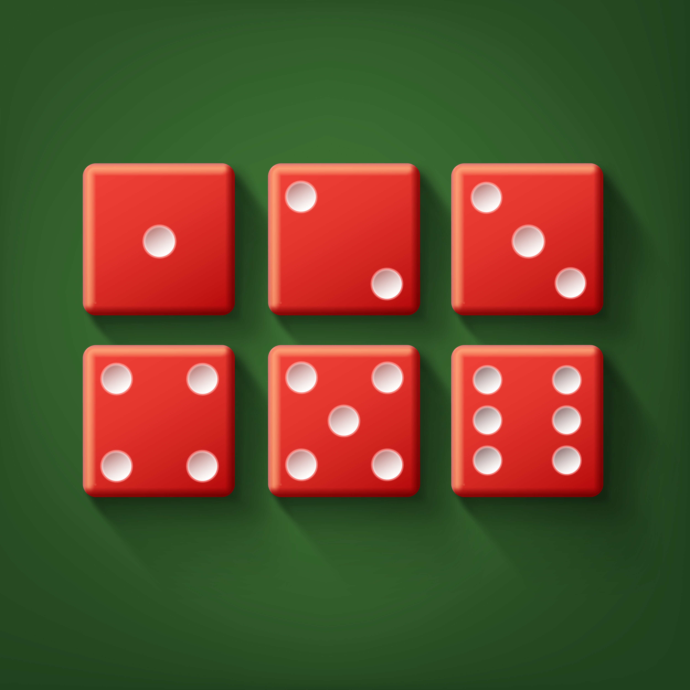
Random
Try randomising some elements with:
random(max)
random(min, max)
For instance filling a shape with a random colour:
  fill(random(255, random(255), random(255));
image

Slide 16
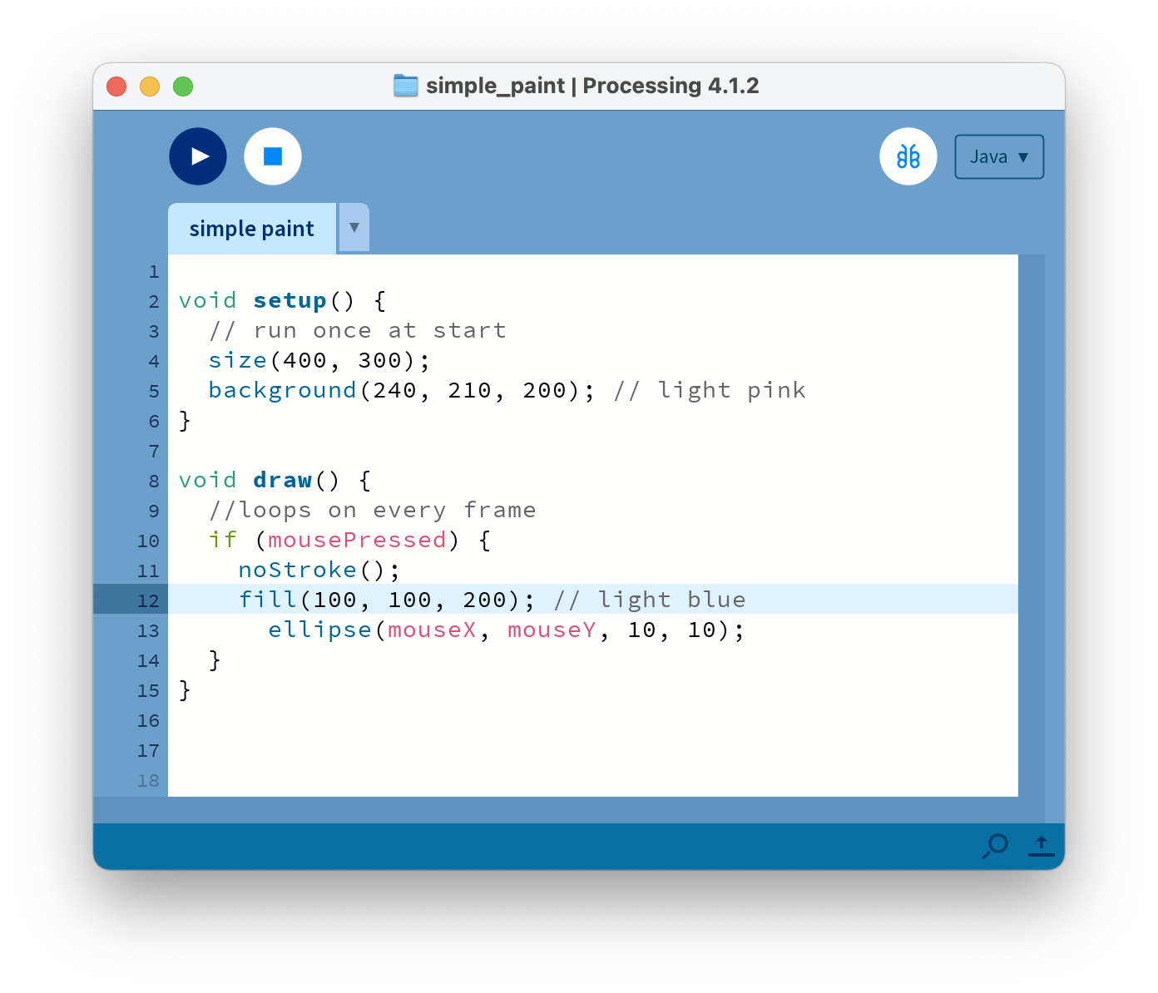
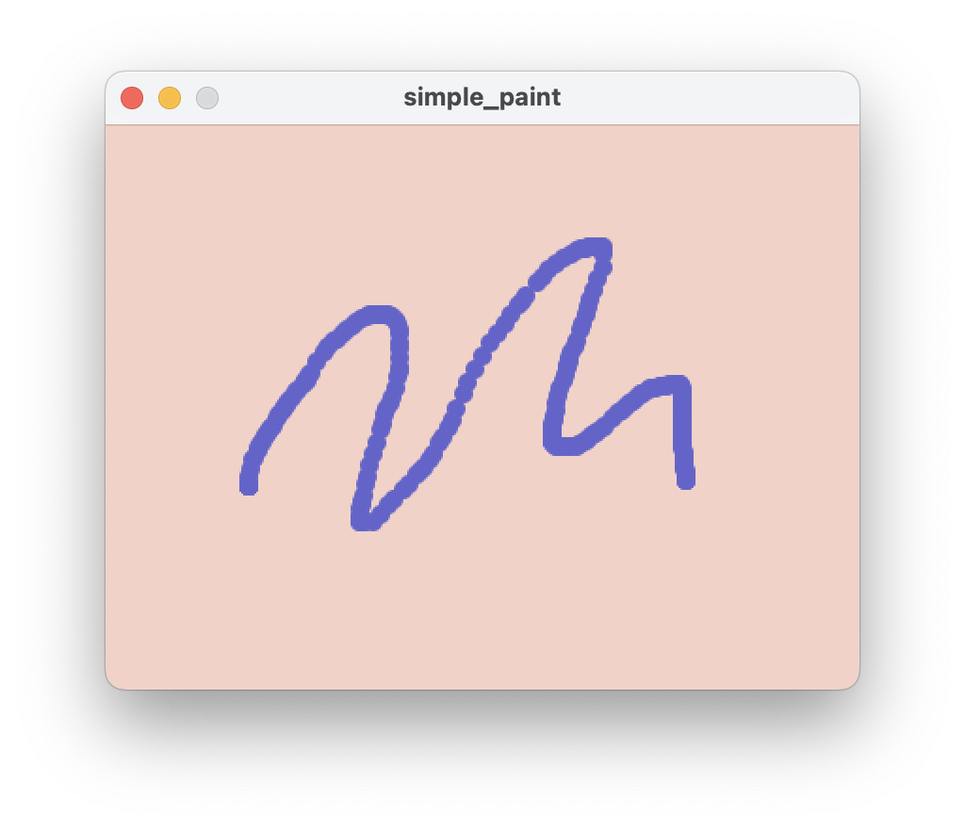

Slide 17
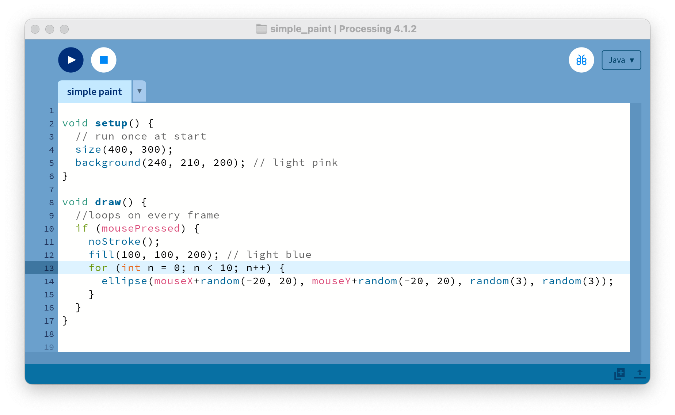
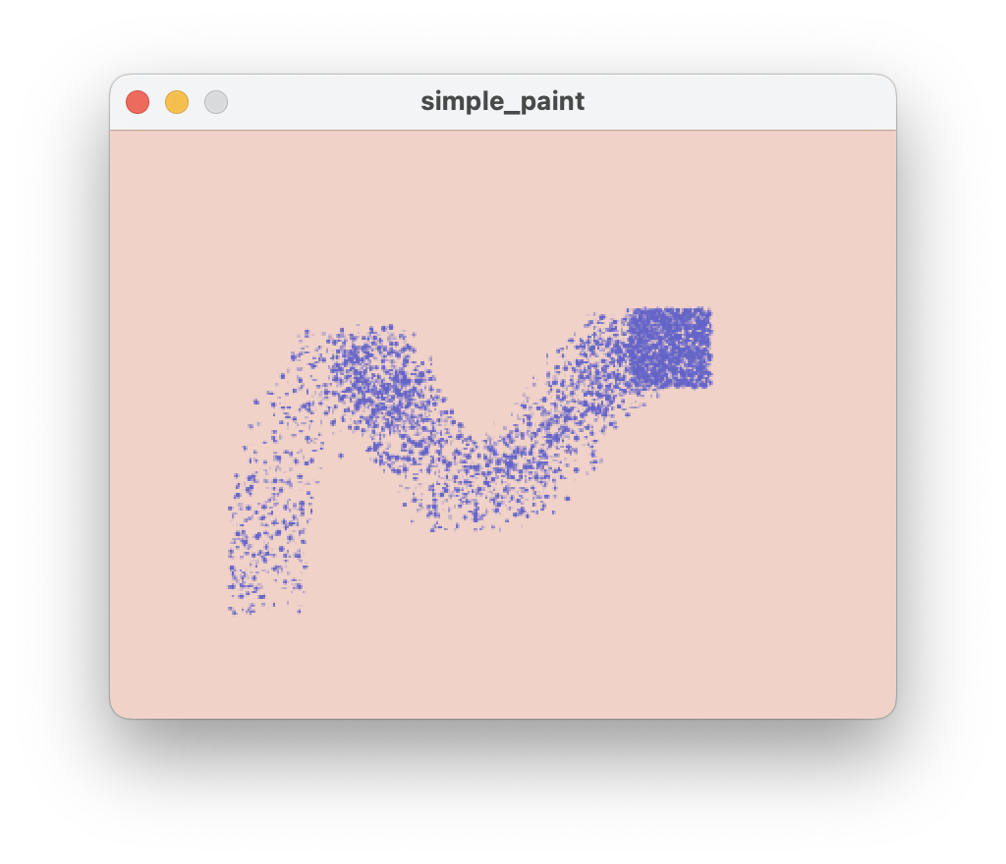
Spraypaint – could be better, perhaps use cos() and sin() to create a circular area rather than a square?

Slide 18
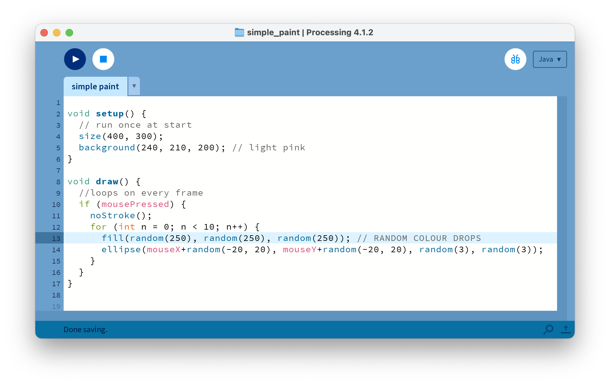
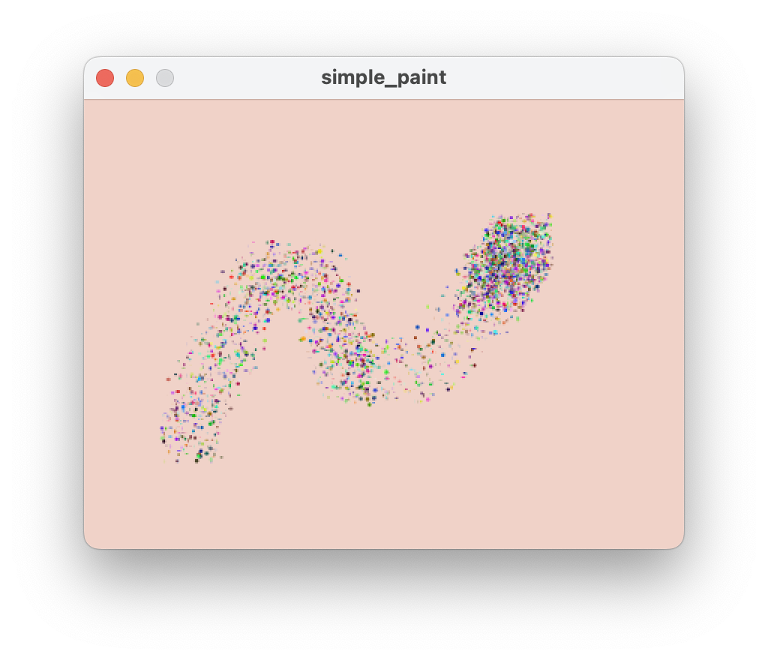
Spraypaint – move the fill() command and change the colour for every drop? Try passing two arguments to random(min, max) for a more realistic palette

Slide 19
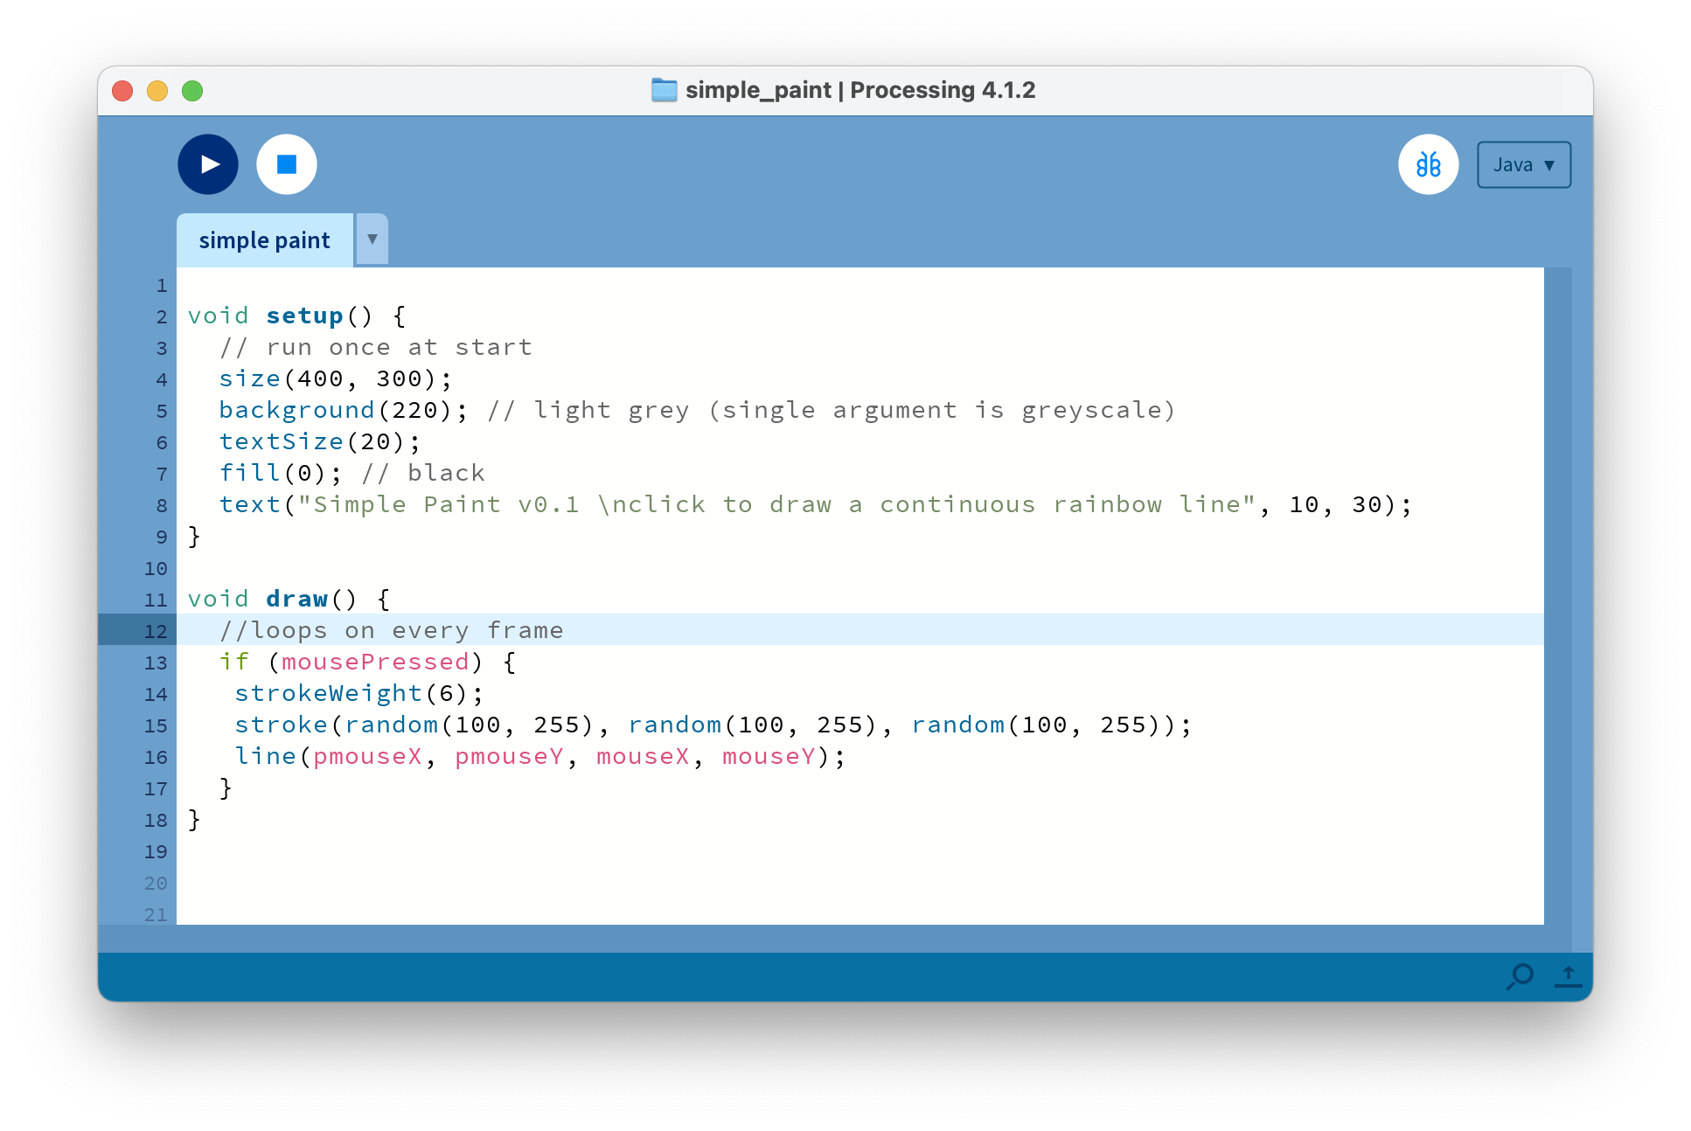
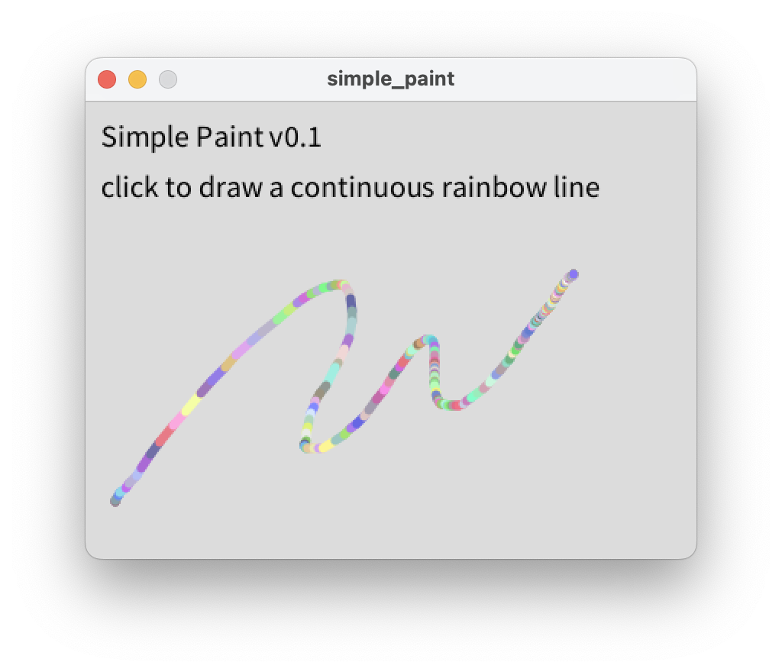
Documentation + Commenting - make sure that a new user can work out how to use your app, and please remember to use comments, either // or /*multiline*/ so that your code is legible

Slide 20
Challenges
These are potential challenges that you could start to fill your Kanban board up with:
Add a way to change brush colour
Change the brush size
Add key commands keyPressed()
Save an image
Multiple brush types, select with a key
Eraser mode
Add a way to reset/clear the whole canvas
Auto-scribbler, automatically nudge the pen around the drawing position
Symmetry – draw a second point on the opposite side of the canvas
Create smooth lines by drawing between last and current mouse position:
line(pmouseX, pmouseY, mouseX, mouseY)
Add opacity to your brush by passing a fourth parameter (0 = transparent, 255 = opaque):
fill(red, green, blue, alpha)
Create lined or grid paper using a for loop.
Change the strokeWeight() of your line based on the speed of mouse movement. Use pmouseX and pmouseY along with mouseX and mouseY to determine the distance moved
NOTE: please add documentation – someone’s going to be using your system without you being able to explain it. Use println() to send text to console or even better text() to write to screen.

Slide 21
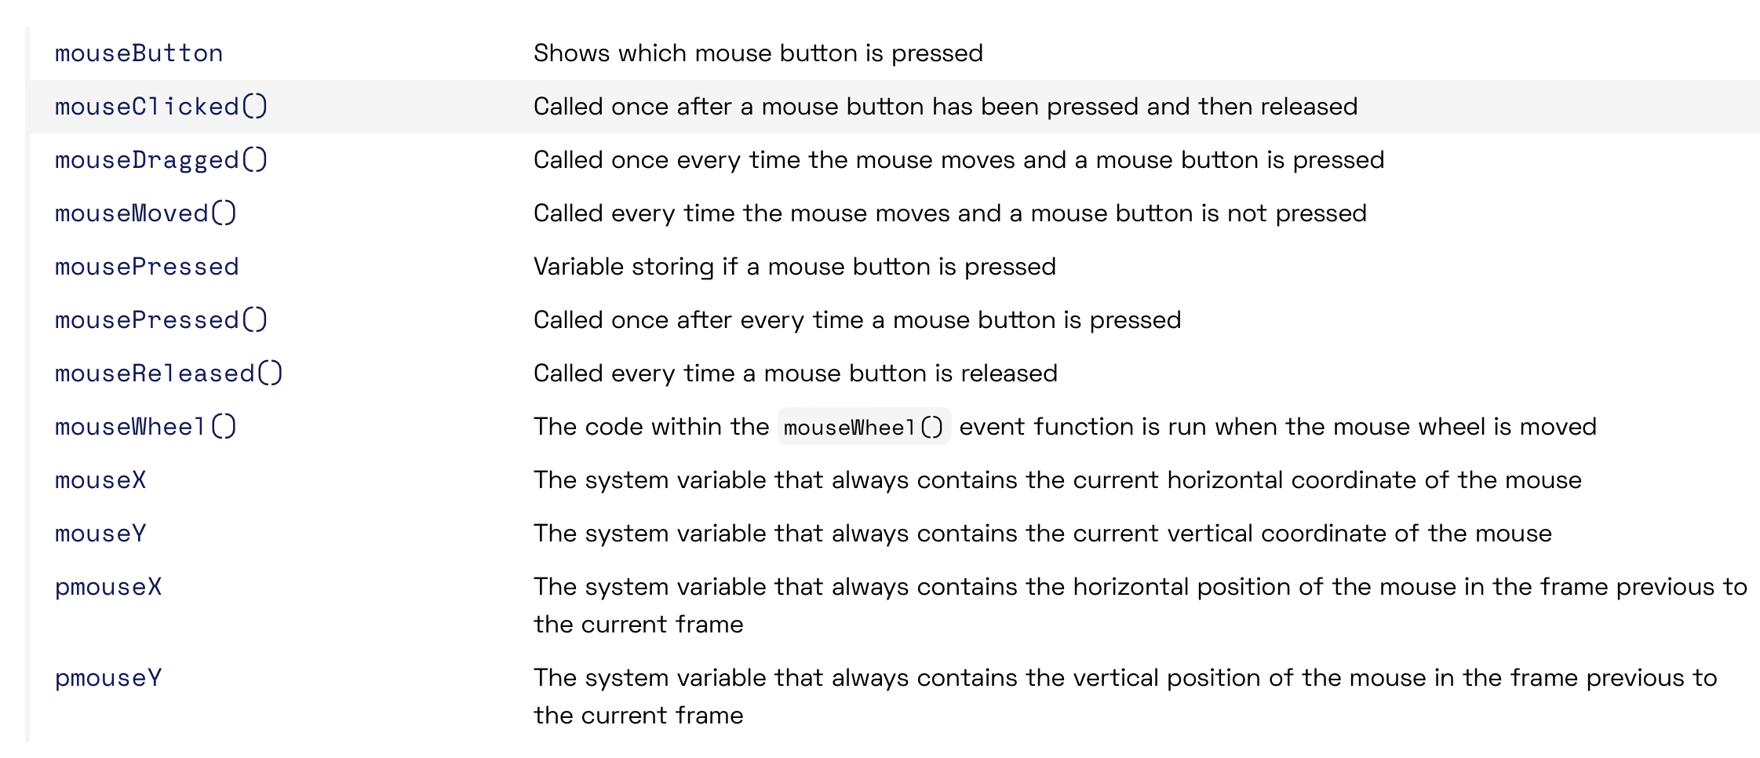
Going Further
Many more functions documented in the Processing Reference:
  https://processing.org/reference
Look through the reference and see what functions could be interesting to try out
More info on the Processing environment here:
  https://processing.org/environment/

Slide 22

Pair Programming + Kanban
~80
mins
Partner up. Swap roles regularly.
Use a Kanban board to plan and track which features you will be working on.
  Not Started - > In Progress -> Done
Start simple! Keep features small.
Consider including a ‘shelved’ or ‘parked’ column to put features in that aren’t working out (given 90min timescale).
Don’t get stuck!

Slide 23
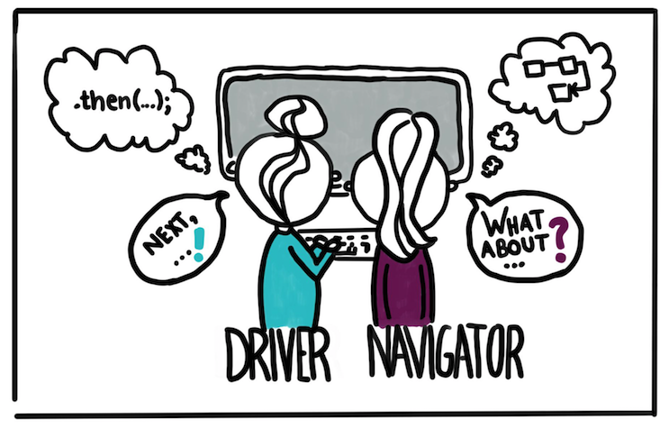
roles in pair programming
Driver (Helm)
The person typing
Focused on the short-term goal
Places longer-term goals on backburner
Talks through what they are doing
Navigator (Tactician)
Observes the drivers work
Reviews code in real-time
Notes suggestions
Scans horizon for longer-term issues

Slide 24
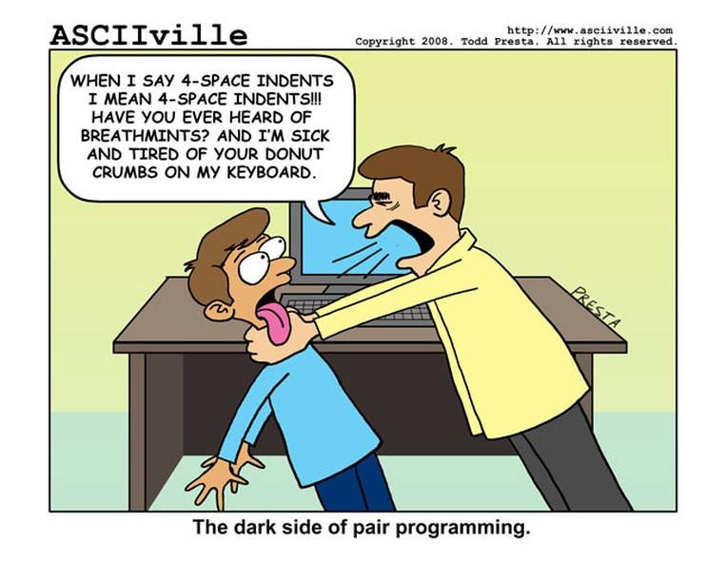
Pair Programming Tips
Distractions. Don't check your phone/mail. Stay focused. Build in more individual time if you need it.
Micro-management. Stick to higher level comments, and avoid saying things such as "now type..."
Impatience. Don't jump right in when the driver makes a typo. They may have seen it and just haven't gone back to correct. Avoid breaking their flow.
Keyboard hogging. Make sure to stick to a rotation schedule and avoid sticking to one role.

Slide 25
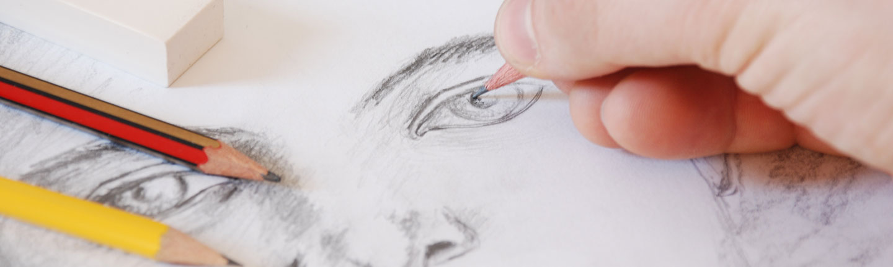
User Testing
15
mins
Find another pair and swap over.
Without any instruction, use their paint app to draw a portrait of your pair programming partner (take turns)
Show the creators of the app how you used it, and your artistic results!
What worked? What didn’t? Did you enjoy it? What would you improve? What was similar with your own? How was the resulting portrait?
image

Slide 27

homework / groupwork
Make sure you can make a commit. Then take and upload a team photo!
Decide on TWO IDEAS to bring along to next weeks workshop.
Add these two ideas to your repo! One paragraph each. Images welcome!

